Slide 1
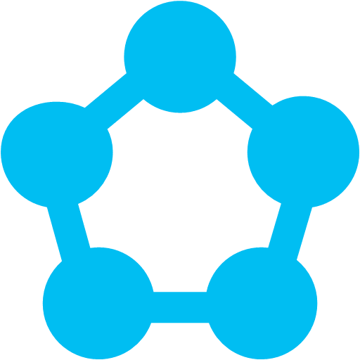
An Introduction to
Azure Service Fabric
created by Mike Wood
mwood@sqlsentry.com
@mikewo

Slide 2


SETTING
EXPECTATIONS
#1
#2
Image: The most important sign you’ll ever seen in a mine by Kevin Dooley / CC by 2.0
Image: Tunneling by jurvetson / CC by 2.0
Notes:
Set expectations!
There isn’t great guidance out yet (Still in preview)
This is not a DEEP Dive. See expectation #1
Images:
Tunneling by jurvetson, used under creative commons attribution license - http://www.flickr.com/photos/jurvetson/3478347891/sizes/l/#cc_license
The most important sign you'll ever see in a mine by Kevin Dooley, used under creative commons attribution license - https://www.flickr.com/photos/pagedooley/2245759343/sizes/o/

Slide 3

WHAT IS SERVICE FABRIC ?
“
a distributed systems platform used to build scalable, reliable, and easily-managed applications for the cloud.
Image: Jedi Salesman by Brad Montgomery / CC by 2.0
Notes:
So, what is Service Fabric?
Service Fabric is the next generation PaaS Service from Microsoft. Service Fabric is a distributed systems platform used to build scalable, reliable, and easily-managed applications for the cloud (or at hyperscale). New buzzword! Huzhaaa!
Sounds like marketing!
Images
Jedi Salesman by Brad Montgomery, used under creative commons attribution license - https://www.flickr.com/photos/bradmontgomery/5378236347/sizes/l/

Slide 4






What PROBLEM is this solving?
Load Balancer
Complex
Stateless Front End
Slow Deployments
Handle HA
Resource Distribution
Stateless Middle-tier
Cache
Handle Partitioning
Multiple Deploy Models
Storage
Notes:
What problem is this solving?
Traditional architecture today (layered and scaled out, with caches and external stores.)
Lots of complexity
Slow deployments
We have to build in all the HA and partitioning when needing to scale (or rely on the cloud provider)
We end up writing code that works on way on premises, another in Azure, another in AWS, etc.
In Azure Cloud Services it’s not easy to package up multiple applications for deployment. In fact, it’s down right stick in the eye painful. So we end up pushing out a lot of VMs or spending a lot of time dealing with multi-threading workers or making them smart enough to do many things. But you still don’t get around the upgrade cycle being slow.

Slide 5
What is SERVICE FABRIC?
Microservices
Service Fabric
Container Orchestration & lifecycle management
Application Programming Models
High Availability
Hybrid Operations
Data Partitioning
Health Monitoring
Self-healing
Simple programming models
High Density
Rolling Upgrades
Low Latency
Placement Constraints
Replication & Failover
Stateful services
Fast startup & shutdown
Load balancing
Hyper-Scale
Automated Rollback
Management
Communication
Reliability
Hosting
Subsystem
Testability
Windows
Linux
Windows
Linux
Azure
Hosted Clouds
Federation
Windows
Linux
Private Clouds
Transport
Slide stolen borrowed from Microsoft
Notes:
What is Service Fabric?
The core of Service fabric is a set of services residing on a cluster of machines. The service fabric can live on Windows for now, but they plan on making it available for Linux as well. They want the same service to run on Azure, Private clouds or even other providers like Amazon and RackSpace.
The set of services provide all the benefits you see in the purple, without a lot of work on your end. These are the things that all of the different groups in Microsoft were duplicating for each of their services until Service Fabric was started.

Slide 6





What is SERVICE FABRIC?
Nodes
System Services
Cluster manager
Failover manager
Naming
Image store
Cluster
習
Notes:
What’s running on a cluster?
Service Fabric services
Failover Manager
Cluster Manager
Image Store
Naming
Let’s look at a cluster on my box! (Show Fabric Explorer)
DEMO 1 – Service Fabric Cluster

Slide 7






WHO’S USING
SERVICE FABRIC
Azure Core Infrastructure
1000s of machines
Azure DocumentDB
Billions/tx/wk
Azure SQL DB
> 1.4 Million DBs
Bing / Cortana
500m evals/sec
Event Hubs
20bn events/day
Skype for Business
Notes:
Who’s using Service Fabric
Microsoft is, and has been for several years now.
The use this for Azure DocumentDB, SQL Database, Cortana, Bing and more.

Slide 8
MICRO SERVICES
///
SHOPPING CART
WEBSITE
INVENTORY
Logic + State Unique Name Communicates Consistent Hosted
BILLING
SHIPPING
USER PROFILES
Notes:
Service Fabric is a great platform for Microservices.
Buzzword bingo!
What is a microservice? My definition is decomposing a large solution down into independent services.
There is significant discussion on the web about the definition of microservices, and how they may (or may not) differ from Service Oriented Architecture (SOA). We aren’t going to dive into that here, but I’ll give you the definition that Microsoft presents when talking about microservices in regards to Service Fabric.
It’s logic + State that is independently versioned, deployed and scaled.
Unique name that can be resolved.
Interacts with other microservices over well defined interfaces and protocols (like REST)
Remains logically consistent in the presence of failures
Hosted inside of a “container” (code + config)
Can be written in any language or framework (node.js, Java VMs, any EXE)
Developed by a small engineering team

Slide 9
TYPES OF MICROSERVICES
No state (external)
N instances
Stateless
OR
Stateful
Authoritative State
Partitioning with N consistent copies
Notes:
Create either Stateless or Stateful services
- Stateless – Web sites, Gateways, proxies, workers, etc.
- Stateful – Shopping carts, devices, game data, user profiles
When something is stateful the data is stored on the disk of the nodes. It can survive even cluster outages unless you lose too many of the drives themselves. You can also push out to an external store if you like or implement your own persistence provider.

Slide 10
Microservices
Programming Model Options
Reliable Actors API
Reliable Services API
SMALL INDEPENDENT UNITS
LOGIC ACROSS COMPONENTS
SINGLE THREADED
RELIABLE COLLECTIONS
MANAGED CONCURRENCY
CONTROL GRANULARITY OF STATE
MANAGED COMMUNICATION
CONTROL COMMUNICATION
Notes:
Two different programming models to choose from:
Reliable Actors APIs
Your problem space involves many small independent units of state and logic
You want to work with single-threaded objects while still being able to scale and maintain consistency
You want the framework to manage the concurrency and granularity of state
You want the platform to manage communication for you
Reliable Services APIs
You need to maintain logic across multiple components
You want to use reliable collections (like .NET Dictionary and Queue) to store and manage your state
You want to control the granularity and concurrency of your state
You want to manage the communication and control the partitioning scheme for your service

Slide 11

Solving the PROBLEM
Load Balancer
Reduces Complexity
Stateless Service
Fast Deployments
Managed HA
High Density
Stateful Middle-tier
Managed Partitioning
Single Deploy Model
External Data stores
習
Notes:
You can combine multiple models within the same application. For example, a stateless web service which connects to a stateful service to host a shopping cart or user profiles.
Let’s go back and look at the sample we used as our problem space early on in the talk.
We reduce complexity because we no longer have the external cache and queues to deal with.
The High Availability and partitioning of the data can be managed by the Service Fabric, so we no longer have to code much of that on our own.
Much faster deployments.
The fabric handles spreading the deployments out so that we don’t have to and can pack more onto each machine.
And since we deploy to the same fabric regardless of environment we have a single code base. No more providers for S3 vs Blob Storage, or Simple Queue Services vs Azure Queues.
We push to an external store for data analysis or for disaster recovery.
Visual Object sample!
Graphic of stateless web service for clients to attach to and stateful Actor model in the background for the shapes.
Demo 2 – An application walk through
I’m going to show an sample that includes a stateless service and a stateful actor so you can see a little about how it’s coded, but I don’t want to dive too deep into. This is a sample that Microsoft provides so you can pull the code and look through it to your heart’s content. There are also several good videos on the Reliable Actor model you can watch to learn more.

Slide 12

You are not
Constrained
Image: Handcuffs by Victor / CC by 2.0
Notes:
And you aren’t really constrained. You can host any exe you want pretty much in a stateless service and just start up a listener. You get the service fabric HA benefits and more.
Images:
Handcuffs by Victor, used under creative commons attribution license - https://www.flickr.com/photos/v1ctor/6711234961/sizes/l/

Slide 13

DEPLOY
Image: F5 Deploy by Mike Wood / CC by 2.0
Notes:
How do you deploy?
Well, F5 of course! Visual Studio will certain do a deployment to your local cluster, but when you redeploy it will remove the package and replace it, killing any state you may have. And of course, you wouldn’t use Visual Studio to deploy to production right…. Right?
Images
F5 Deploy by Mike Wood, used under creative commons attribution license

Slide 14




DEPLOYMENT
Service Package
Code + Configuration
Config
Code
Application Package
One or more Service Packages + Configuration
Config
P₁
P₂
S₁
S₁
Image Store
習
Cluster
Notes:
A service package – made up of code and configuration.
An application package – made up for one or more service packages and configuration. Unit of deployment, versioning and lifecycle.
The build produces your code, which you then package into separate service packages, which are comprised of code and configuration (service manifest). Then one or more service packages are put together into an application package which is comprised of the service packages and configuration (application manifest). Each of these is then is considered a service or application Type. Think of it like a .NET CLR type. You define it, then you instantiate one more instances of it.
The application package is copied to the cluster on the imagestore service.
Then you start the application, which will create an instance of the application on the cluster based on the configuration.
Demo 3 – Deployment and updating

Slide 15
HYPERSCALE
Stateless
…
0…9
Stateful
1
B
Primary + Secondaries
Singleton
1
…
1
10…19
Secondary
Named
B
…
20…29
Ranged
…
Z
1
Secondary
Cluster
Notes:
So, this is supposed to scale like mad right?
Stateless services scale by just creating more instances of them. A Load Balancer then directs traffic round robin between them.
Stateful services scale by using partitions. When you deploy the stateful service it has a number of partitions defined. Your options are:
Singleton (The Highlander option - there can be only one!)
Named – this works off unique names and you must know the partition name. For example, if you wanted to partition by customer ID or zip code (these are NOT dynamic, so beware). You’d have to know the name and likely have a look up service to find them.
Ranged Partitioning (int64) – You define the upper and lower bounds of the range and then the number of partitions.

Slide 16

YOU MUST CHOOSE,
BUT CHOOSE WISELY
You can only set the partitions when you create the application. It CAN NOT be changed.
Image: Indiana Jones and Last Crusade, Copyright LucasFilm 1989
Notes:
Partition size is defined in the application manifest and currently can NOT be changed after deployment, so choose wisely.
You can test the system by putting in a test load against it configured for one partition and see where it starts to fail or hang. Then you'll known the load you roughly get for each partition since all the requests for a single partition will go to the primary node. Then you can extrapolate how many nodes you'd likely need for your anticipated load. Then add some growth in there and set it for that many partitions.
Note that #partitions != the number of nodes in your cluster. You can still start with a smaller number of nodes until you are under pressure.
Due note that thousands of partitions will stress smaller cluster sizes because of the amount of partitions it may need to move in case of node failures, etc.
Image:
Indiana Jones and the Last Crusade, copyrighted by LucasFilm 1989 / Fair Use

Slide 17

TESTABILITY
“ We adore chaos because we love to produce order.“
- M C Escher
習
Image: Monkey by Samuel Rogers / CC by 2.0
Notes:
Chaos Monkey anyone?
They have tooling available to help you test out both graceful and non graceful faults in the system. The videos show a sample service that is randomly doing this, but there is an API and PowerShell cmdlets you can use to do the same thing, or be more tailored in your testing. Kind of cool.
Service Fabric has been around for a few years within Microsoft. They have actually a very flexible platform with a lot of things built in. The Chaos tooling is nice (and something most people first started hearing about from Netflix).
Demo – 4 – Kill it!
Images:
Monkey by Samuel Rogers, used under creative commons attribution license - http://flickr.com/photos/130732751@N03/16615120856/sizes/h

Slide 18

WHAT DID WE LEARN TODAY?
Service Fabric can solve problems
Exceedingly flexible and powerful
Not a golden hammer
Complexity may be … moved
Image: 15028-UCD Pacific Place-3448 by A&M Commerce / CC by 2.0
Notes:
Azure Service Fabric solves a bunch of problems we have and has the potential to take away a lot of complexity from us in our code.
Azure Service Fabric will solve a lot of problems, but it may not be for everyone.
Need minimum of 5 nodes in a cluster, though on premises it can be jacked to 3 if you don’t mind lose of reliability. (You can put a lot on those nodes though, multiple applications)
Don’t forget you can run just about anything in the service fabric, even non “SF” based programming models. Any .exe.
There is still load balancing that has to happen OUTSIDE the SF. When they get to Azure this will likely be handled by the Azure Load Balancer or Azure App Gateway.
Complexity may appear elsewhere… like versioning. ☺
Image:
15028-UCD Pacific Place-3448 by A&M Commerce, used under creative commons attribution license - https://www.flickr.com/photos/tamuc/16437509712/sizes/z/

Slide 19
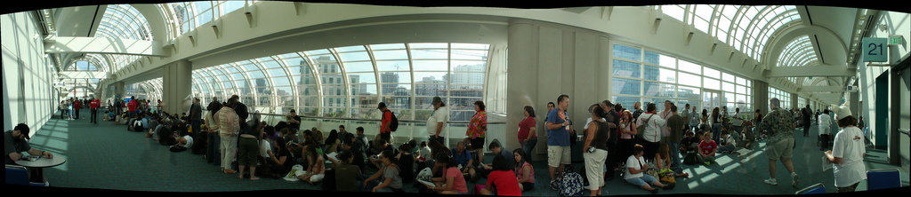
///
PREORDER?
Download the SDK
Azure Public Preview by EOCY (maybe)
Coming to on-prem with Windows Server 2016
Publically state goal of having Service Fabric on Linux & other cloud providers
Image: The Lost Queue by Ewen Roberts / CC by 2.0
Notes:
Can I preorder now?
You can pull the SDK now for a local playground on a single box.
Publically mentioned on a forum post that public preview by EOCY for Azure.
You’ll find this on premises with Windows Server 2016 where the servers can be used as nodes.
They’ve publically stated they want to take this to other platforms (like Linux) and cloud providers (like AWS, RackSpace, etc.)
Think you have a huge opportunity for this? Let me know.
Image:
The Lost Queue by Ewen Roberts, used under creative commons attribution license - https://www.flickr.com/photos/donabelandewen/195930391/sizes/l/

Slide 20



mwood@sqlsentry.com
twitter.com/mikewo
THANK YOU
mvwood.com
Get Started at http://bit.ly/azureservicefabric

